Slide 1
ATA Tele-ICU SIG Meeting
October 20, 2020

Slide 2
Update on ata website issues
Request for access to email addresses for SIG members – will be complete by September 30th. Email addresses will be available on the SIG home page next to each name of the member for view by SIG leaders only
Notification of Open Forum posts real time – will be completed by September 30^{th.} In addition to adding a real time email, we are changing the daily digest to a weekly digest. So there will be a real-time post and a weekly summary email for all comments.
Storage of additional documents – This is currently available. Anything attached to a post shows up in the library. Improving library design (for storage of documents) – will be complete by end of 2020
Member Directory – will be relaunched and accessible by end of 2020

Slide 3
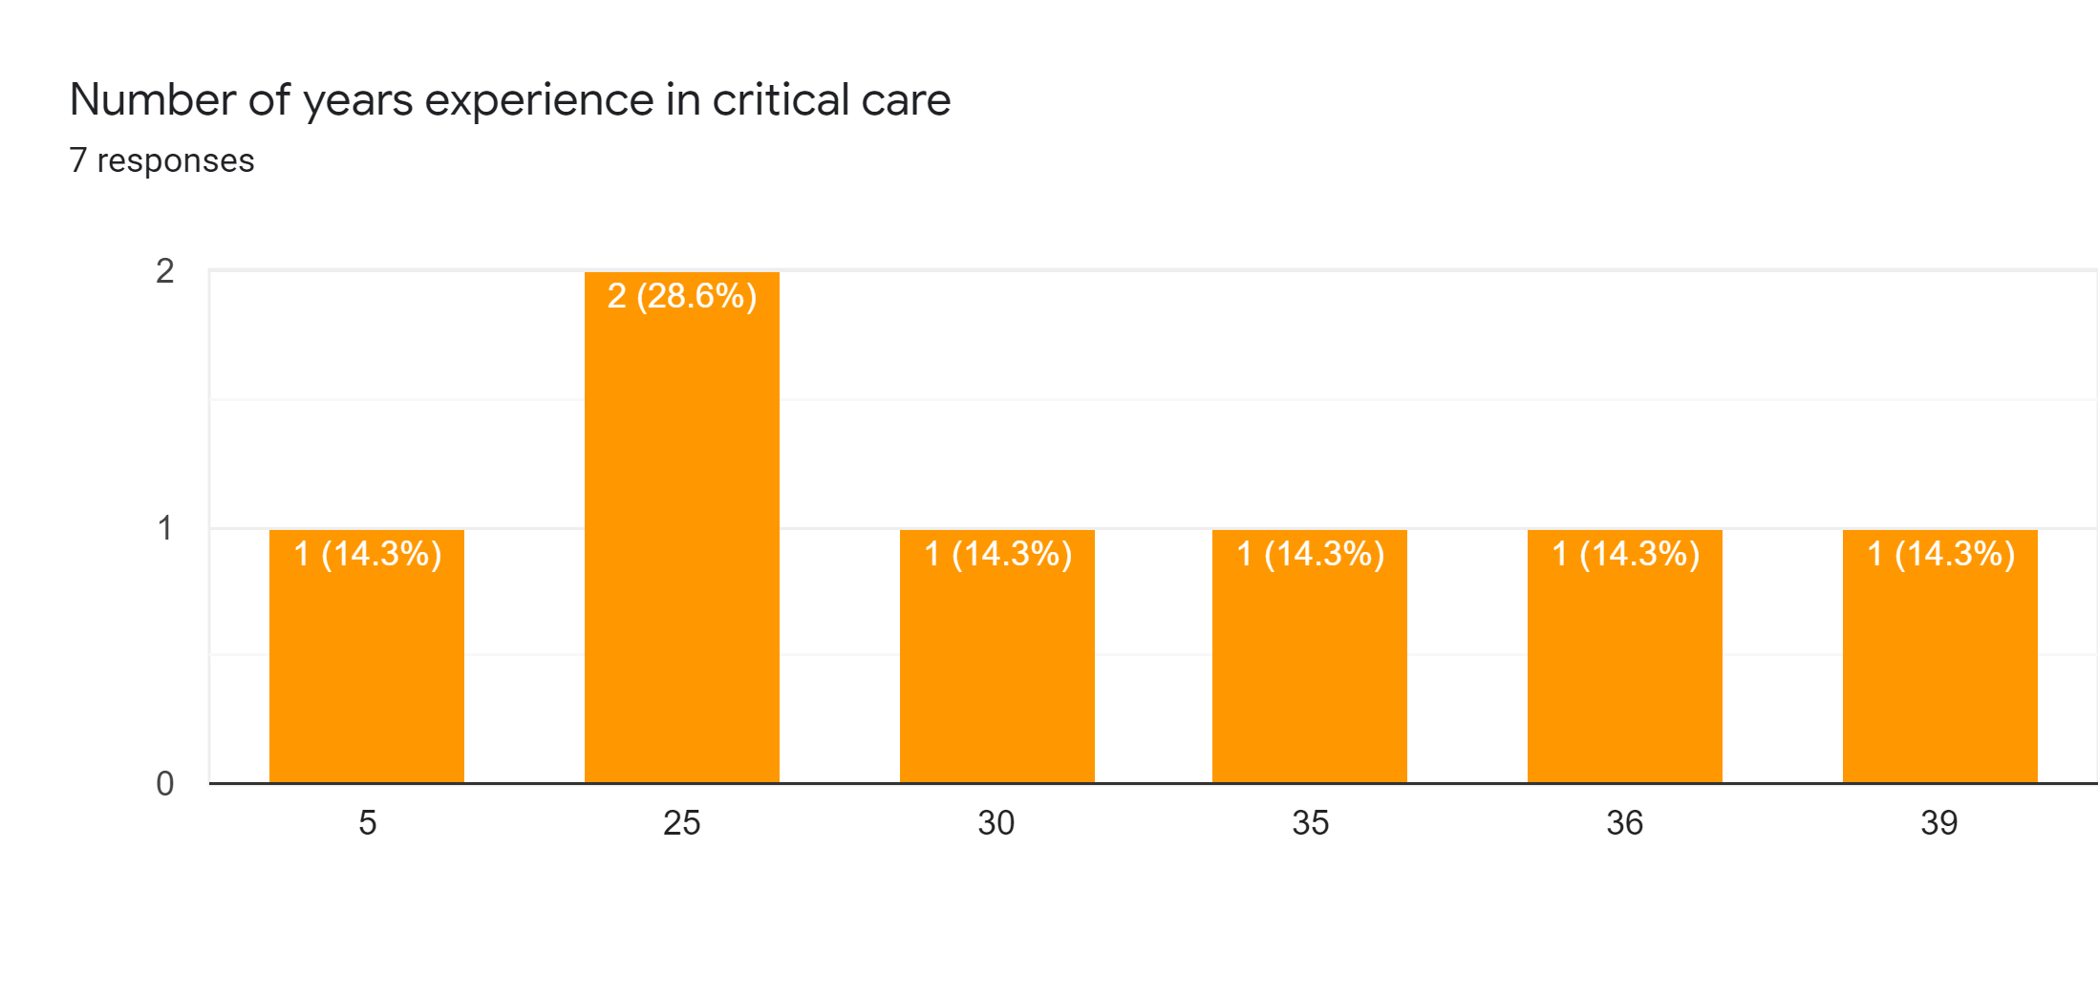

Slide 4
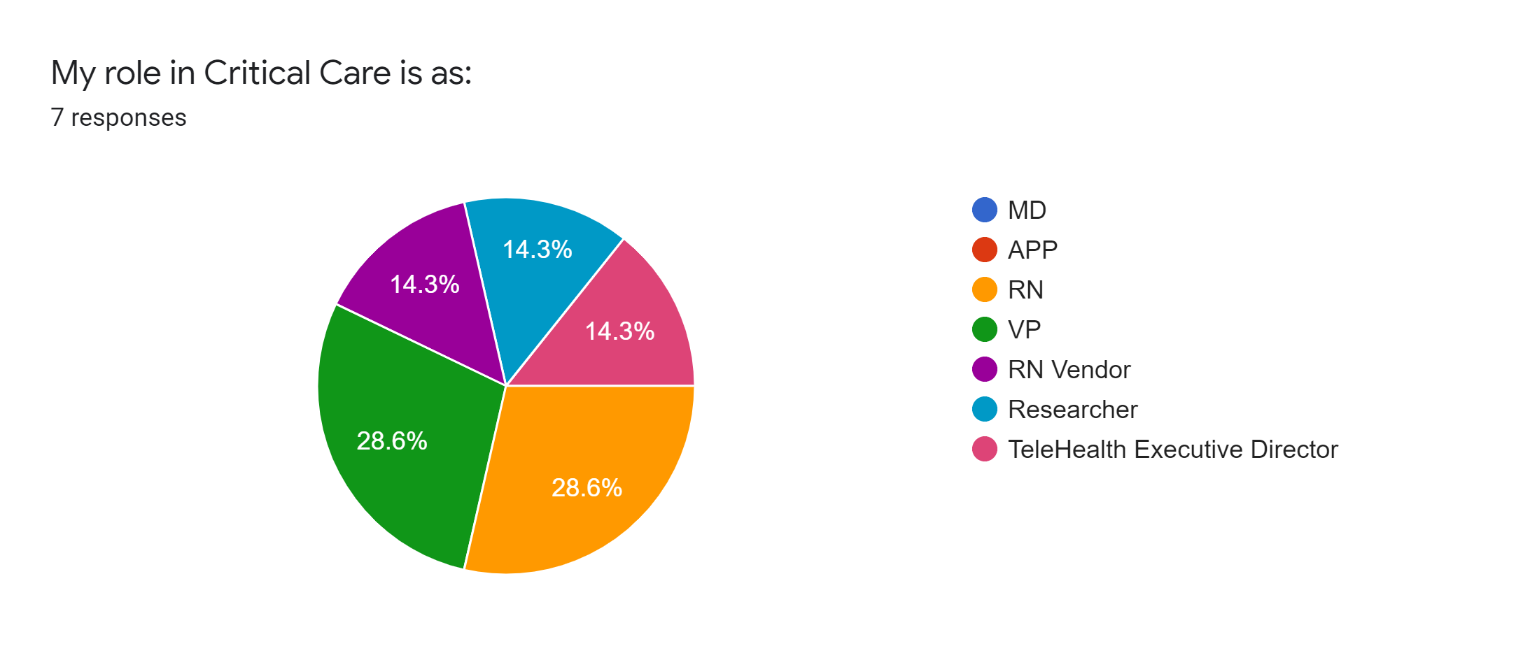

Slide 5
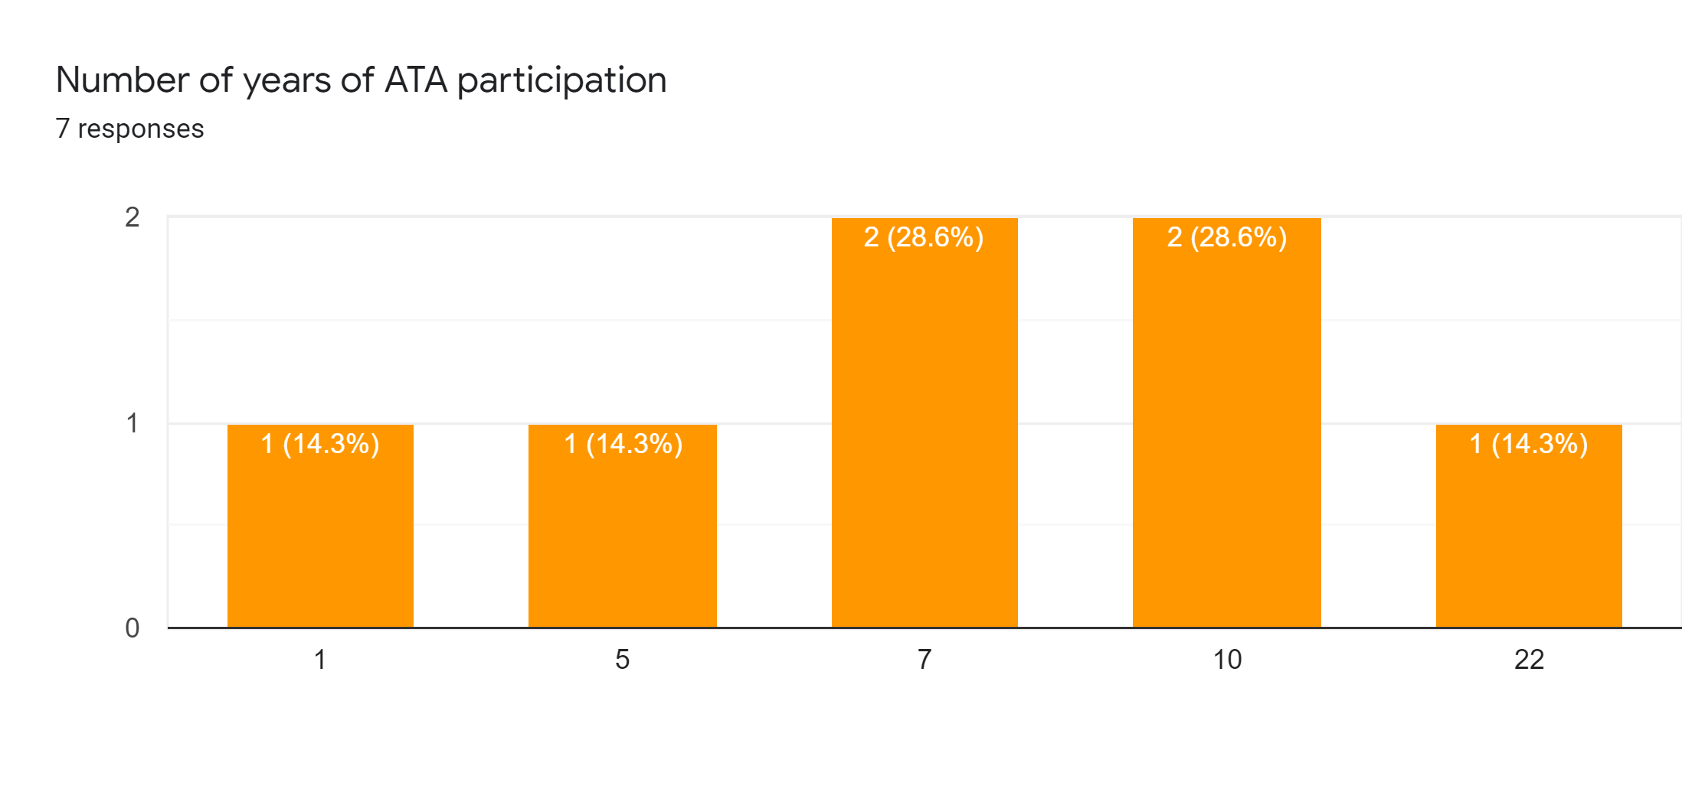

Slide 6
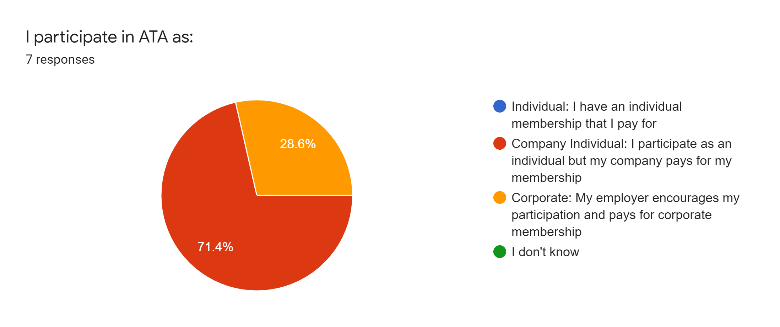

Slide 7
What do you expect from the SIG?
Explore innovative ways to leverage teleICU technology
Thought leadership and mind sharing
cutting edge information on advances in technology and clinical practice, sharing of successes and failures, collaborative work in advancing the technology and service delivery of remote critical care, potentially publishing together. presenting as a group at other conference opportunities/endeavors at all levels (spreading the use case and potential for remote presence use)
to discuss best practice and explore opportunities to support each other as well as reduce regulatory barriers
Networking with like minded professionals, Updates on best practices in delivery of healthcare services.
Stand up for clinicians and advocate for licensure, public policy around payment and access equity, and make sure members are the most important part of ATA.

Slide 8
What do you want from SIG membership that you don’t receive now?
Broader participation and input from my peers
the group needs to grow and entice more to participate, to diversify the participation, maybe tool kits with sample/recommended analytics, staff scripting for consent and education, survey development for others to review and compare their programs....
more volunteerism and desire to assist with mission of SIG
a voice at the Board table

Slide 9
What, if anything, limits your active participation in the SIG?
The time of the meetings
Day and Time of on line meetings
busy days....
work schedule not always compatible with meetings.
Schedule, topics of interest
difficulty with ATA membership website, having to sign up over and over again, the need to put my name on a survey

Slide 10
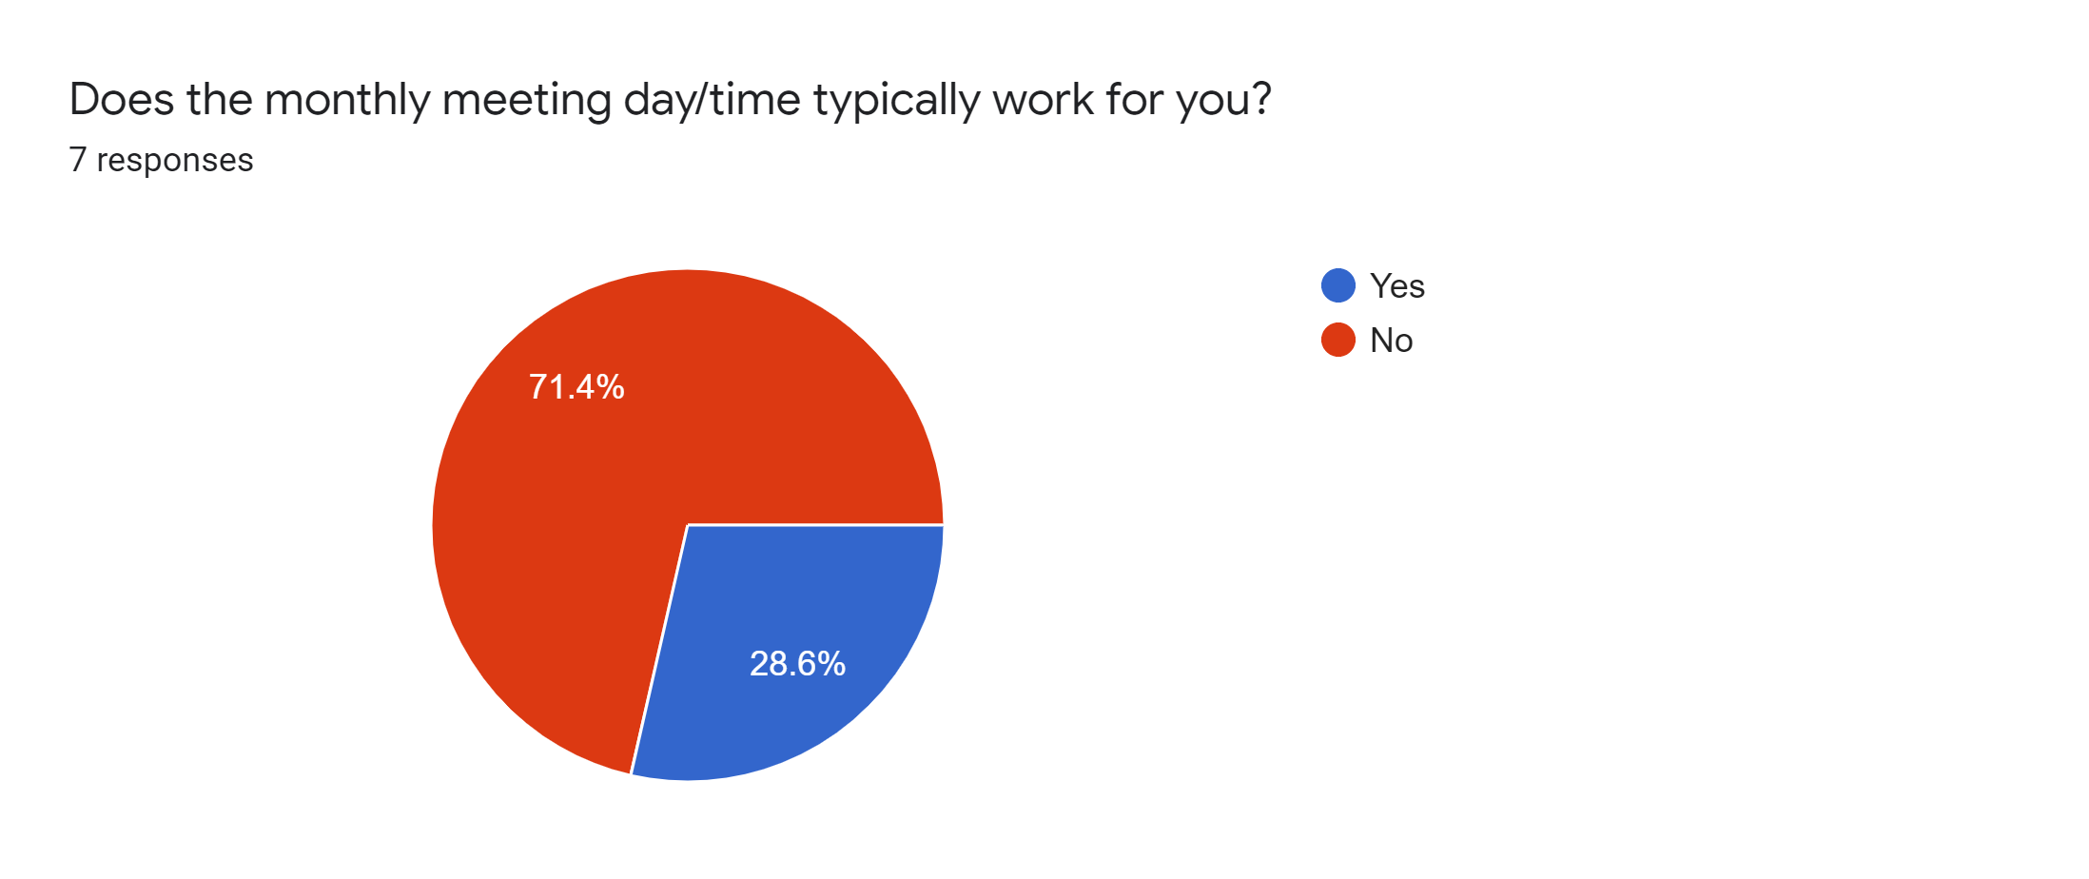

Slide 11
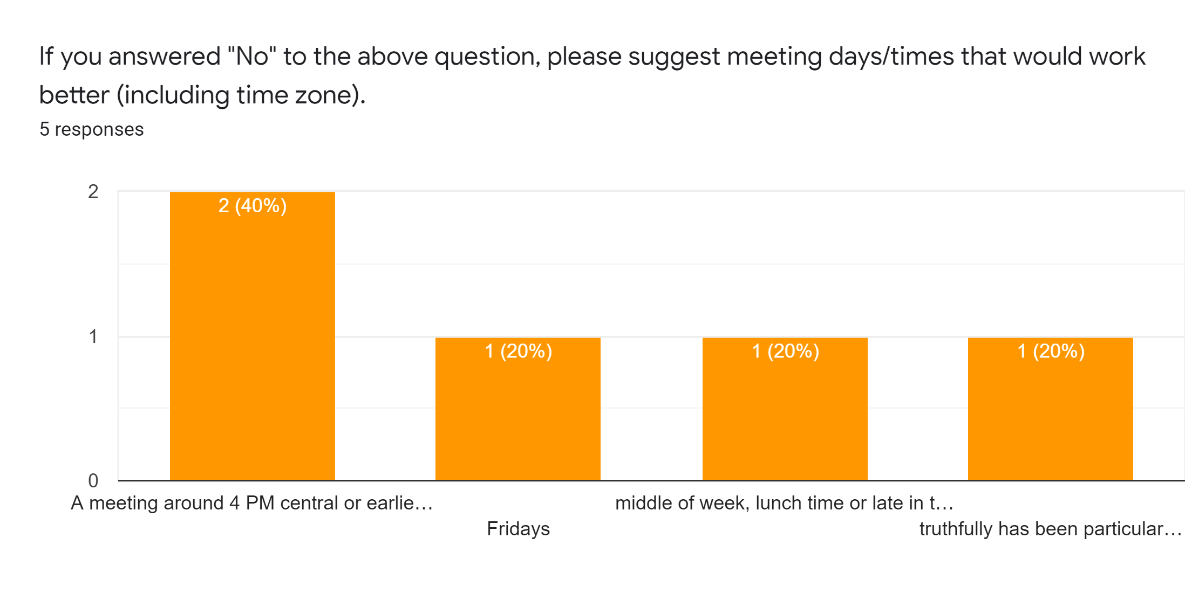

Slide 12
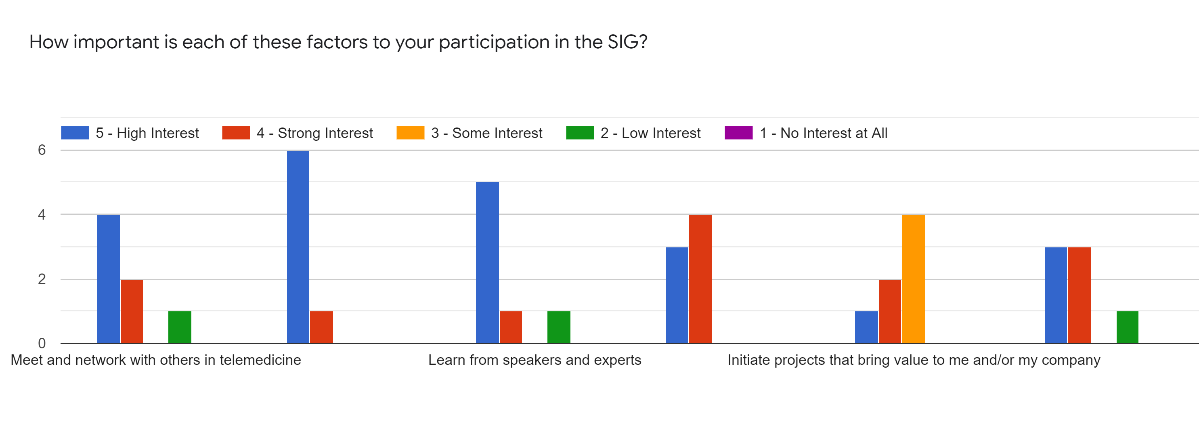
Meet and network with others active in teleICU
Work with others to address key issue in teleICU
Have access to expert resources

Slide 13
What other factors motivate your participation in the SIG?
Attempting to get value from my membership
Positive motivation of the group
networking and content interest
maintaining relationships and having ability to network beyond the scheduled meetings

Slide 14
Development of TeleICU training
TeleICU & bedside collaboration

Slide 15
What other topics or speakers would you like to suggest?
Any examples of leveraging TeleICU outside of the ICU or in collaboration with other telemonitoring
AI and telehealth; Nurse Burnout
analytics, evaluating ROI, evaluating program reception, optimizing a service
recognition of TeleICU as a field of practice.

Slide 16
